Slide 1
Erasmus+ Capacity Building projects
in the field of Higher Education
Call 2015
CONTRACTUAL MANAGEMENT OF THE GRANT
  Project Representatives Meeting
Brussels, 27-28 January 2016

Slide 2

The aim of this presentation
Approach and rules for sound contractual
management:
  Essential information on the E+ Capacity Building in Higher Education Grant Agreement and other important documents

Slide 3
Presentation Content
Structure of the Grant Agreement
Hierarchical order of content
Special Conditions
General Conditions
Guidelines for the Use of the Grant
NB: please note that this document has no legal value

Slide 4
Grant Agreement
Multi-beneficiary
Mixed-Financing Actual and Unit Costs
Duration 24 or 36 months
5 Budget Headings

Slide 5

1. STRUCTURE OF THE GRANT AGREEMENT

Slide 6
I. Special Conditions
II. Annexes
Annex I: Description of the action
Annex II: General Conditions
      Part A: Legal and Administrative Provisions
      Part B: Financial Provisions
Annex III: Estimated budget of the action
Annex IV: List of beneficiaries and Mandates
Annex V: Model Technical Implementation report(s)
Annex VI: Model financial statement(s)
Annex VII: Report of Factual Findings on the Final Financial Report

Slide 7
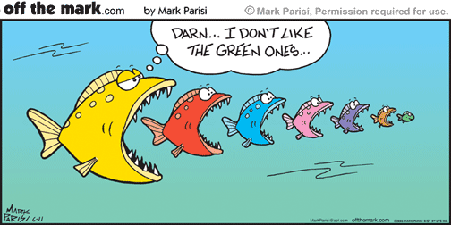
2. HIERARCHY

Slide 8





CALL FOR PROPOSALS
Grant Agreement: SPECIAL CONDITIONS
Annex II
Grant Agreement: GENERAL CONDITIONS
_
Other Annexes
Project Proposal (Annex I)

Slide 9
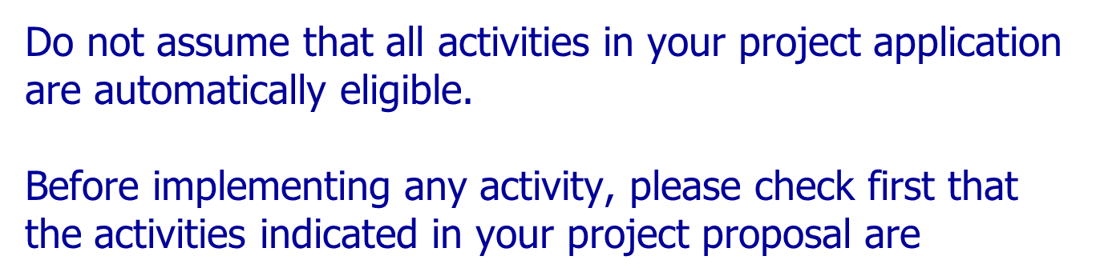

BEWARE!
eligible

Slide 10

3. SPECIAL CONDITIONS

Slide 11
  Subject matter of the Agreement (Article I.1)
  Entry into force and Duration (Article I.2)
  Amount and form of the grant (Article I.3)
    Annex III – Estimated budget
    Maximum grant amount & form
      Actual costs (Equipment & Subcontracting)
      Unit contribution (Staff, Travel and Costs of Stay)

Slide 12
Payment Cycle (Art. I.4)
1st pre-financing: 50%
Upon entry into force of the GA 
When 70% of first
pre-financing is used
60 days following the
reception of the FR
Statement of the costs
+
Request for Payment
Progress Report
Due date:
14/10/16 – 2 years
14/04/17 – 3 years
2nd pre-financing: 40%
 half-way through the project lifetime
Financial Statement
+
Request for Payment
Final Report
Due date:
14/10/17 – 2 years
14/04/18 – 3 years
Audit Report
balance: max 10%
Required for all grants
 Max 2 months after the project ends

Slide 13
Bank Account (Article I.5)
  Account or sub-account must identify the payments made by EACEA
  Recommended to use a specific account to identify transactions
  Preferable to use account in EURO to avoid fees
Communication details (Article I.6)
  - ONE contact person for all communications with EACEA
Use of the results, intellectual and industrial property rights (Article I.7)

Slide 14
Budget transfers (Article I.8) -> Financial Management workshop
Law Applicable and Competent Court (Article I.9)
2 situations:
EU: General Court of the European Union
Partner Country: Courts of Brussels - Belgian law

Slide 15
Other Special Conditions (Article I.10)
  Award of contracts & subcontracting
  Exchange Rates
  Depreciation
  Ineligible costs
  Partnership Agreement: compulsory
  -> to be sent to EACEA within 6 months of the signature of the Grant Agreement

Slide 16

Other Special Conditions (Article I.10)
  Meetings between coordinating institution and EACEA
    compulsory up to twice per year
    Provision for travel and costs of stay
  11. Cooperation obligation with NEOs, International Contact Points and EU Delegations

Slide 17
Dissemination & exploitation of results (Art. I.10.8 )
Obligation to provide substantial visibility of project results:
  - Set-up website at the beginning of the project
  Erasmus+ Projects Results Platform
  Aim: To provide information on EU-funded projects to demonstrate efficiency and effectiveness to the EU-taxpayer.

Slide 18
Publicity obligations (Art. I.10.9)
Sticker
  Project publications and results:
  Must display this Logo:
  Must mention " Co-funded by the Erasmus+ Programme of the European Union"
  https://eacea.ec.europa.eu/about-eacea/visual-identity_en
  Include disclaimer:
    "This project has been funded with support from the European Commission. This publication [communication] reflects the views only of the author, and the Commission cannot be held responsible for any use which may be made of the information contained therein".
  http://ec.europa.eu/dgs/education_culture/publ/graphics/beneficiaries_all.pdf

Slide 19
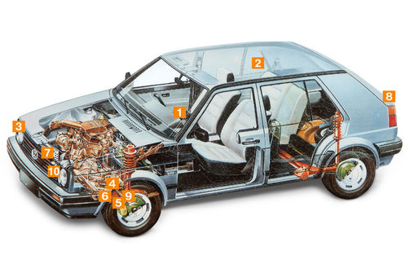
PENALTIES
Breach of contractual obligations
Publicity
Weak Implementation

Slide 20
Penalties for weak implementation (Art. I.10.6)
Reduction of the final grant in the event of weak implementation
When does the performance evaluation take place?
During the implementation of the project
  At Progress Report stage
  As a result of a Monitoring visit
After the completion of the project
  At Final Report stage
When is the coordinator informed?
  After the assessment of the progress report (warning)
  After the assessment of the final report (final decision)

Slide 21
How will the project performance be assessed?
The evaluation of the project performance will be based on the same criteria and the same scoring scale as those used at application stage:
  • Relevance (max. 30 pts)
  • Quality of the project (design and) implementation (max. 30 pts)
  • Quality of the project team and cooperation arrangements (max. 20 pts)
  • Impact and sustainability (max. 20 pts)
What could be the impact of a weak performance?
EACEA will apply the following reduction of the project maximum grant
  25% : performance score between 40 points and below 50 points
  35% : performance score between 30 points and below 40 points
  55% : performance score between 20 points and below 30 points
  75% : performance score below 20 points

Slide 22
Penalties for non-compliance with publicity obligations (Art. I.10.10)
When does the performance evaluation take place?
At the same time as the performance assessment: i.e. at reporting stages as well as during field monitoring visits.
How are the publicity obligations verified?
Verification on project website and on the project documents (studies, reports, promotional material, etc.)
What is verified?
Respect of the Visual Identity
Presence of the acknowledgement on the co-funding of the Erasmus+ Programme
Presence of the Disclaimer concerning the content of the product

Slide 23
Penalties for non-compliance with publicity obligations (Art. I.10.10)
When is the coordinator informed?
At any time when a non-compliance situation is identified.
What could be the impact of a non-compliance?
EACEA may apply a 20% reduction of the maximum grant awarded.

Slide 24
Administrative and financial Penalties
(Art. II.17)
When?
When the beneficiary has
committed substantial errors, irregularities or fraud; or
made false declarations or failed to submit information; or
been in serious breach of contractual obligations.
What type of penalties could be applied?
Administrative penalties: exclusion of all contracts or grants for a max. duration of 5 years
Financial penalties: 2 to 10% of the beneficiary's grant contribution

Slide 25

4. GENERAL CONDITIONS

Slide 26
Part A: Legal and Administrative provisions
Role and obligations of the Beneficiaries (Article II.1)
  - Multi-beneficiary Grant Agreement
    - Mandates: contractual link between EACEA and all beneficiaries
      All beneficiaries are jointly responsible for the project:
      In case of recovery
      In case of audits, checks or evaluation in their premises

Slide 27

  Communication between the parties (Article II.2)
  Damages (Article II.3)
  Conflict of interest (Article II.4)
    between the person's self-interest and professional or public interest
    Applicable to all project activities
    Financial impact ineligible costs
    In case of doubt, inform the Agency
  Confidentiality (Article II.5)

Slide 28
Supplementary Agreements (Article II.12)
Amendments:
Extension of Eligibility Period
Budget modification
Addition , Modification or Withdrawal of a beneficiary
 No later than one month before the end of the project!

Slide 29
TYPES OF AMENDMENTS
Participant Portal
legal status of the coordinator and/or beneficiaries
E-mail
contact person of the coordinator
Scanned letter
coordinating institution
legal name of the coordinator and/or beneficiaries
address of the coordinator
address of a beneficiary (not the coordinator)
deadline for submission of reports
eligibility period
budget breakdown
partnership composition
legal representative of the coordinator
bank account of the coordinator
the work programme

Slide 30
Some other key points :
Force majeure/Suspension (Article II.14 & II.15)
Termination Procedure and effects (Article II.16)
Financial Penalties (Article II.17)
  For grave breaches of obligations under the Agreement

Slide 31
Part B: Financial provisions
  Eligible and Ineligible Costs (Article II.19)
  Requests for Payment (Article II.23)
  Determining the Final Grant (Article II.25)
  Recovery (Article II.26)
  -> cf. Workshop on Financial Management

Slide 32
  Checks and Audits (Article II.27)
The Agency and/or the Commission may carry out technical and financial checks and audits in relation to the use of the grant
Checks, audits or evaluations made by the Agency and/or the Commission may be carried out either directly by its own staff or by any other outside body authorised to do so on its behalf
Checks/audits: during the implementation of the Agreement and for a period of five years starting from the date of payment of the balance

Slide 33

5. GUIDELINES FOR THE USE OF THE GRANT

Slide 34

Guidelines for the Use of the Grant
Valuable reference document
Cover a multitude of questions and different situations
Available on the E+ CBHE Website
  https://eacea.ec.europa.eu/erasmus-plus/beneficiaries-space/capacity-building-in-higher-education_en
Check regularly updated versions!

Slide 35

QUESTION NOT ANSWERED?
Please contact the E+CBHE team
EACEA-EPLUS-CBHE-PROJECTS@ec.europa.eu
Don't forget to mention your project number!
Notes:
Please use this mailbox when sending your e-mails, with your PO in Cc.

Slide 36




GRANT AGREEMENT
ANNEXES
CALL
Guidelines for the Use of the Grant
PROJECT
PROPOSAL
Email the E+ CBHE team
Notes:
Last slide that maps all the different documents available for you as reference to ensure a proper management of your Grant Agreement.

Slide 37


